Slide 1
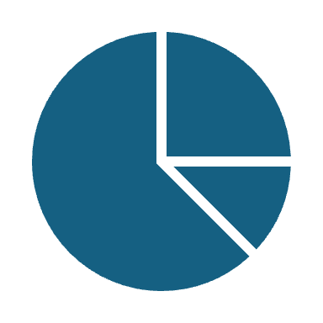
Trendify Data-Driven Insights
Improving customer satisfaction through delivery analysis
Data Science Consulting Presentation Presented by Maryam Abdulhuseynova

Slide 2
Welcome to Trendify: Improving Customer Experience
Trendify is a fast-growing e-commerce platform in Brazil.
Connects thousands of sellers with customers across Brazil
Competes on delivery speed, review quality, and customer retention
Facing challenges with delivery delays, negative reviews, and inconsistent seller performance
Now seeks data-driven insights to improve customer experience and operational efficiency
"As Trendify scales, smart insights become critical to stay competitive."

Slide 3
Our Mission as Data Consultants
Identify key drivers of poor customer experience (e.g., bad reviews, late deliveries)
Detect underperforming sellers or regions
Build a model to flag potentially problematic orders before they occur

Slide 4
How We Addressed the Business Questions?
Business Question | Approach
Why are some customers dissatisfied? | Merged reviews with delivery metrics to uncover patterns
Which sellers/states underperform? | Grouped by seller/state to analyze delays and negative feedback
Can we predict bad outcomes early? | Trained a model to flag risky orders based on order metadata

Slide 5
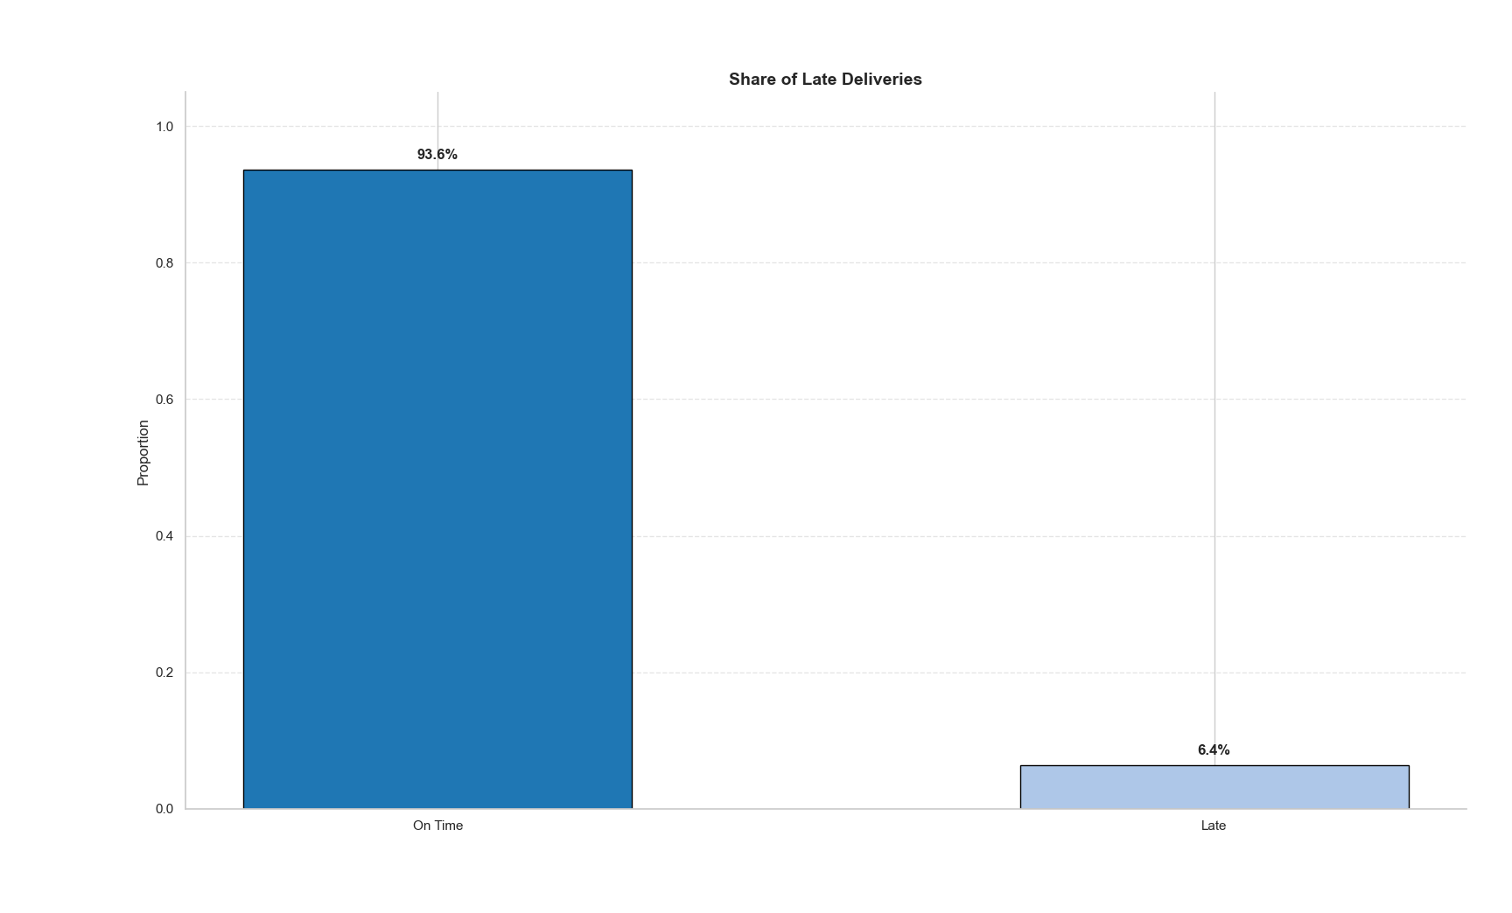
Delivery Performance
Most Deliveries Are On Time — But Not All.
90–95% of deliveries are on time.
Only 6.4% of orders were late, but even a small share of late deliveries can harm the brand.
SO WHAT :
“Customers forgive a lot — except for delays. Reducing the 5–10% late deliveries could prevent a spike in bad reviews.”

Slide 6
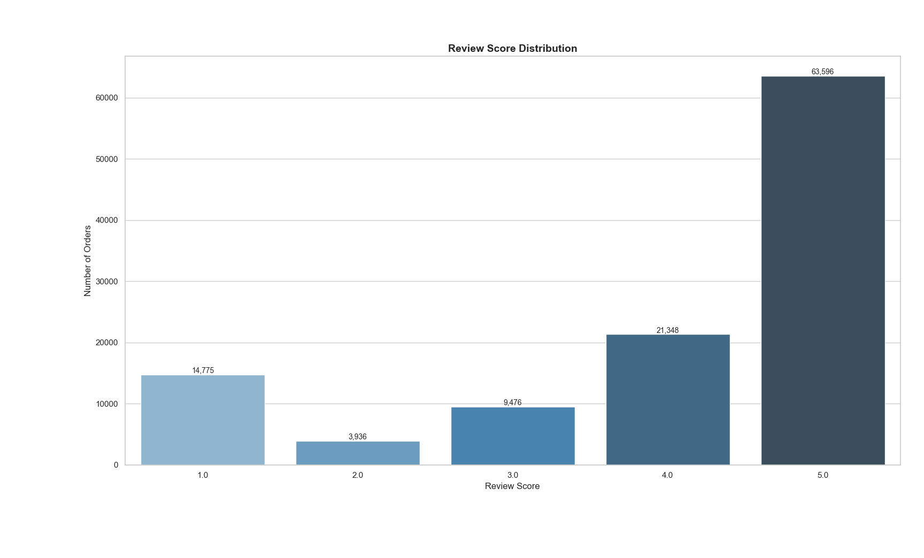
Customer Reviews Breakdown
Most Customers Are Happy — But There's a Tail.
Majority of reviews are 5 stars.
Still, over 18,000 reviews are poor (1–2 stars)
Many poor reviews are linked to delay, poor communication, or fulfilment
SO WHAT?
“We need to dig into what’s causing low scores — because even a small % of bad reviews affects reputation and seller trust.”

Slide 7
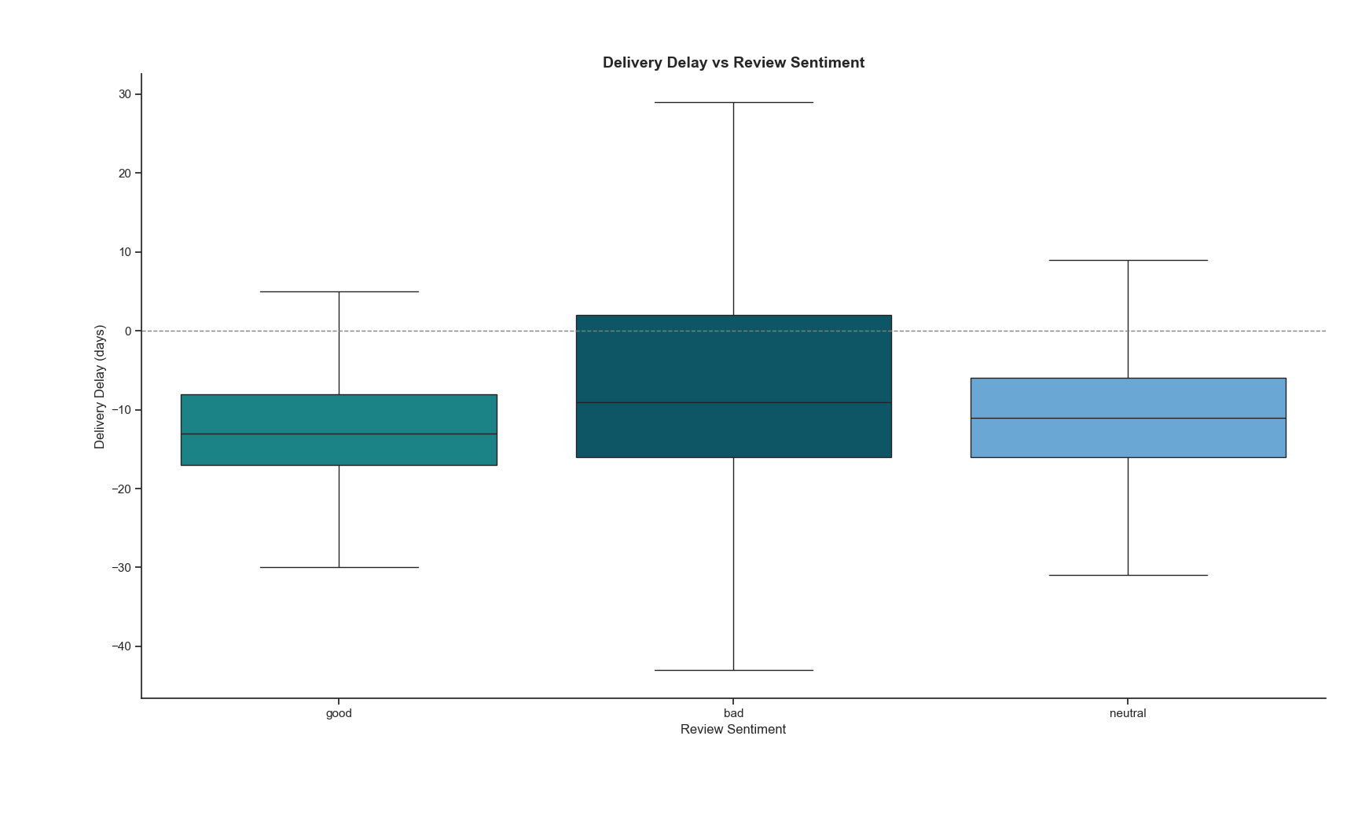
What Drives Bad Reviews?
Late Deliveries Correlate with Bad Reviews.
Late deliveries = higher chance of negative reviews.
On-time deliveries = mostly positive feedback.
Late orders are much more likely to receive 1–2 star reviews
Delay = a key driver of dissatisfaction
SO WHAT?
“Delivery delay is a strong predictor of customer dissatisfaction. Improving logistics = better reviews = more trust.”

Slide 8
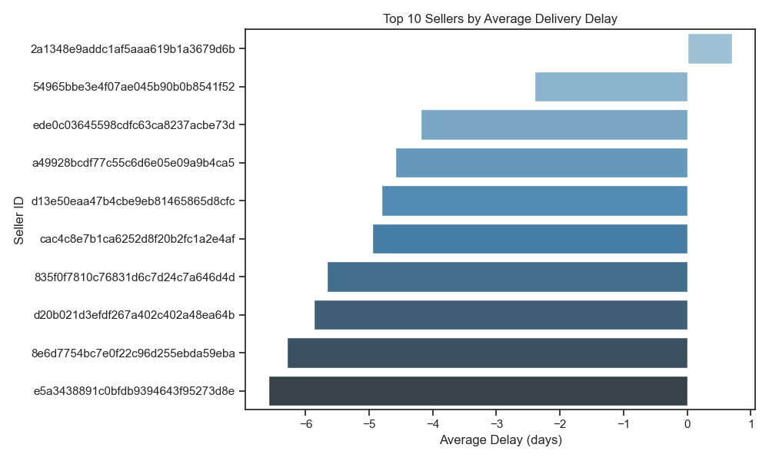
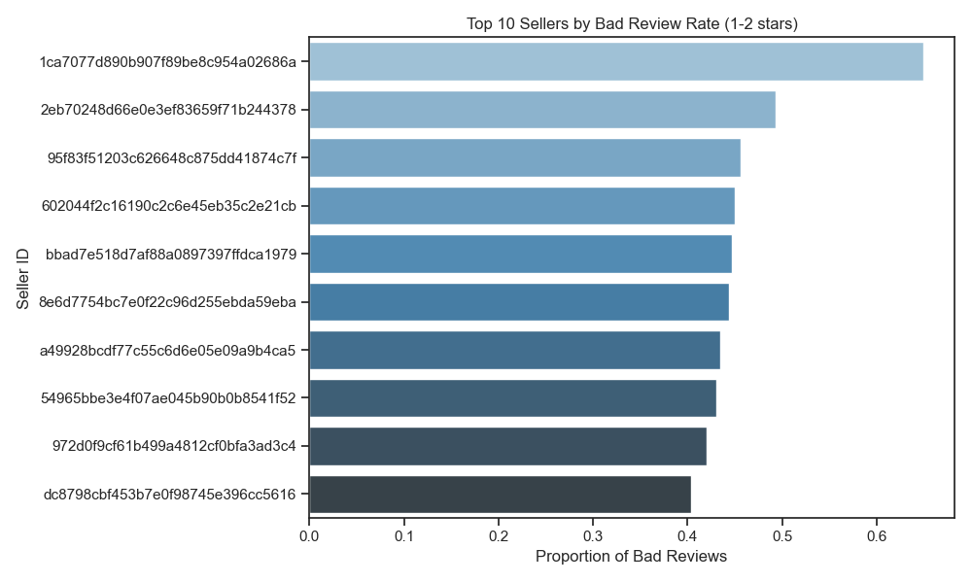
Which Sellers Driving Customer Issues
Some sellers consistently cause long delays
Others have very high bad review rates
“These sellers should be reviewed for process or contract improvement.”

Slide 9
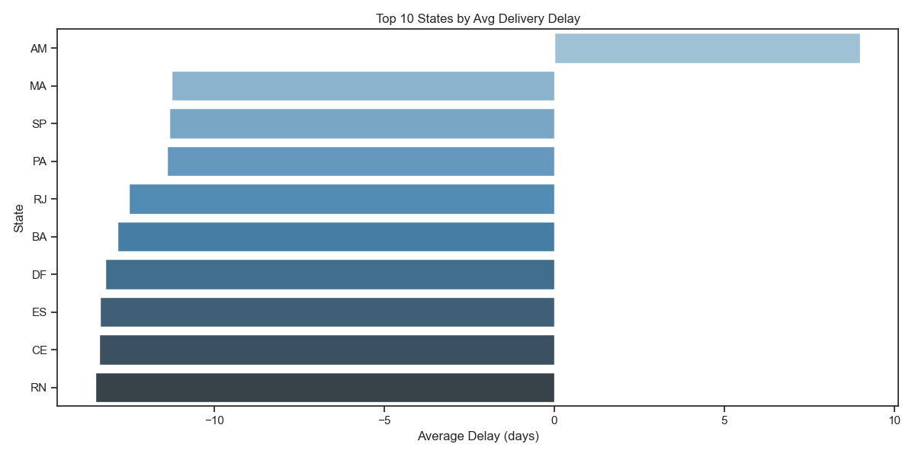
Certain States Are Slower Than Others
States like [e.g., RN, CE, etc.] show higher average delays
Regional logistics partnerships may need re-evaluation

Slide 10
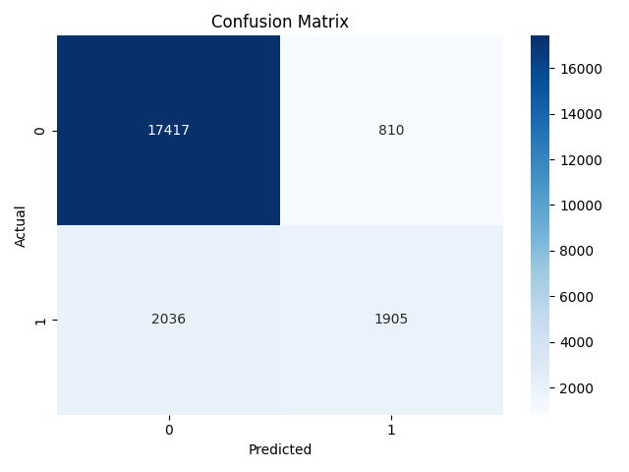
Flagging Problematic Orders Before They Happen
Built a model using features like wait time, freight cost, price
The model helps Trendify proactively detect risky orders at the point of purchase
“Enables smart fulfillment, early warnings & targeted service”
Footnote: Model achieved ~87% accuracy. While recall for problematic orders was moderate (48%), it’s sufficient for early intervention use cases.

Slide 11
Recommendations for Trendify
Prioritise
Prioritise high-risk orders for proactive handling
Logistics
Focus on logistics improvements for high-risk categories in delay-prone regions
Improve
Improve communication for late or high-freight orders
Monitor & alert
Monitor & alert orders predicted to be late
Audit
Audit underperforming sellers and states for SLA compliance
Predict
Use the predictive model to flag risky orders early

Slide 12
Outcome We Delivered
As data consultants, we delivered:
A model that flags orders at risk of delay or bad reviews
Insights into seller performance and regional logistics gaps
Clear actions to improve:
Customer satisfaction
Operational efficiency
Seller accountability
SO WHAT?
This analysis enables Trendify to:
Reduce complaint-related costs
Increase retention via improved delivery and reviews
Target support and contracts based on real performance

Slide 13
What’s Next?
Integrate the model into Trendify’s dashboard
Share insights with seller management and logistics teams
Run A/B test: Use model alerts to reduce complaints
Integrate the predictive model into the order workflow
Set up dashboards for ongoing seller and region monitoring
Pilot proactive customer service flows for high-risk orders

Slide 14

THANK YOU FOR YOUR ATTENTION! ☺

